Slide 1
Capstone Project - The Battle of Neighborhoods
By- Pawan Kumar

Slide 2
Introduction
New York City, often called simply New York and abbreviated as NYC, is the most populous city in the United States. With an estimated 2019 population of 8,336,817 distributed over about 302.6 square miles (784 km2), New York is also the most densely populated major city in the United States.Located at the southern tip of the U.S. state of New York, the city is the center of the New York metropolitan area, the largest metropolitan area in the world by urban landmass. With almost 20 million people in its metropolitan statistical area and approximately 23 million in its combined statistical area, it is one of the world's most populous megacities. New York City has been described as the cultural, financial, and media capital of the world, significantly influencing commerce,[11] entertainment, research, technology, education, politics, tourism, art, fashion, and sports. Home to the headquarters of the United Nations, New York is an important center for international diplomacy.

Slide 3
Problem Description
A restaurant (About this soundlisten)), or an eatery, is a business that prepares and serves food and drinks to customers. Meals are generally served and eaten on the premises, but many restaurants also offer take-out and food delivery services. Restaurants vary greatly in appearance and offerings, including a wide variety of cuisines and service models ranging from inexpensive fast food restaurants and cafeterias, to mid-priced family restaurants, to high-priced luxury establishments.
1.Central and Eastern European immigrants, especially Jewish immigrants - bagels, cheesecake, hot dogs, knishes, and delicatessens 2.Italian immigrants - New York-style pizza and Italian cuisine 3.Jewish immigrants and Irish immigrants - pastrami and corned Meet 4.Chinese and other Asian restaurants, sandwich joints, trattorias, diners, and coffeehouses are ubiquitous throughout the city 5.mobile food vendors - Some 4,000 licensed by the city 6.Middle Eastern foods such as falafel and kebabs examples of modern New York street food 7.It is famous for not just Pizzerias, Cafe's but also for fine dining Michelin starred restaurants. 8.The city is home to "nearly one thousand of the finest and most diverse haute cuisine restaurants in the world", according to Michelin.

Slide 4
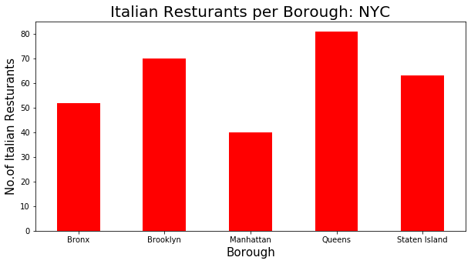

Slide 5
Target Customer
Research your area's demographics. Start by doing some research on your local community. ... Research the competition. Now that you know what types of consumers are in the area, find out how your competition is relating to them. ... Research existing customers. ... Create target customer profiles. ... Evaluate and revise.

Slide 6
Newyork city geographical coordinates data will be utilized as input for the Foursquare API, that will be leveraged to provision venues information for each neighborhood.We will use the Foursquare API to explore neighborhoods in New York City. The below is image of the Foursquare API data.

Slide 7
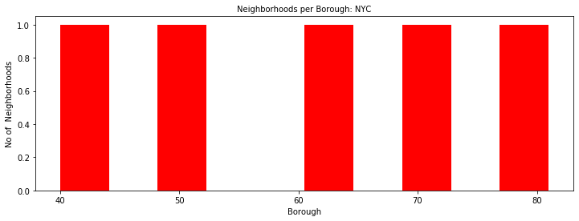

Slide 8
 | Borough | Neighborhood | Latitude | Longitude
0 | Bronx | Wakefield | 40.894705 | -73.847201
1 | Bronx | Co-op City | 40.874294 | -73.829939
2 | Bronx | Eastchester | 40.887556 | -73.827806
3 | Bronx | Fieldston | 40.895437 | -73.905643
4 | Bronx | Riverdale | 40.890834 | -73.912585

